Slide 1

Social Media Strategy Overview
Notes:
This presentation was automatically generated by PowerPoint Copilot based on content found in this document: https://testtestcpdt4-my.sharepoint.com/:w:/g/personal/deba_mvpsandbox_com/EeWQ5Qv-xsZKqz5igU5mfNoBVAaO-IsBpeKUPBn-rSm7oQ?e=6V8XpS AI-generated content may be incorrect.

Slide 2

Agenda
Understanding Your Audience
Identifying Ideal Customers
Setting Clear Goals
Defining Measurable Objectives
Choosing Right Platforms
Effective Platforms for Fashion
Content Strategy Development
Aligning with Brand Identity
Consistent Brand Voice
Maintaining Tone and Style
Paid Advertising Benefits
Reaching Wider Audience
Notes:
Agenda * Understanding Your Audience * Identifying Ideal Customers * Setting Clear Goals * Defining Measurable Objectives * Choosing Right Platforms * Effective Platforms for Fashion * Content Strategy Development * Aligning with Brand Identity * Consistent Brand Voice * Maintaining Tone and Style * Paid Advertising Benefits * Reaching Wider Audience * Influencer Collaborations Impact * Boosting Credibility and Sales * Engagement and Community Building * Prompt Response and Interaction * Analytics and Optimization * Tracking Metrics and Adjusting Strategy * Real-Time Strategy Adaptation * Staying Updated on Trends * Summary and Additional Resources * Creating Meaningful Connections * Exploring Further Articles

Slide 3
Understanding Your Audience
Key Principles

Slide 4

Identifying Ideal Customers
Understanding Your Ideal Customers
Identify demographics, interests, and behaviours of potential customers
Guiding Content Creation
Use audience insights to tailor marketing content
Selecting the Right Platforms
Choose platforms where your target audience is most active
Notes:
To kickstart your marketing strategy, focus on identifying your ideal customers. Understand their demographics, interests, and behaviours to tailor your content and choose the right platforms for engagement. Original Content: Begin by identifying your target audience. Who are your ideal customers? What are their demographics, interests, and behaviours? Understanding your audience will guide your content creation and platform selection.

Slide 5
Setting Clear Goals

Slide 6

Defining Measurable Objectives
Defining Clear Social Media Goals
Identify specific and measurable objectives
Align goals with overall marketing strategy
Examples of Social Media Objectives
Increase brand awareness through targeted campaigns
Drive website traffic to boost online presence
Boost product sales via social media promotions
Engage with followers to build community
Notes:
Let's focus on defining specific, measurable objectives for our social media efforts, such as increasing brand awareness, driving traffic, boosting sales, or engaging with our followers. Original Content: Define specific, measurable objectives for your social media efforts. Examples include increasing brand awareness, driving website traffic, boosting sales, or engaging with followers.

Slide 7
Choosing Right Platforms

Slide 8

Effective Platforms for Fashion
Platform Effectiveness Varies by Brand
Not all platforms suit every brand's needs
Identify Your Audience's Preferred Platforms
Understand where your target audience is most active
Popular Platforms for Fashion Brands
Instagram, Facebook, Pinterest, and TikTok are commonly used
Notes:
When it comes to social media, not all platforms are a perfect fit for every fashion brand. It's crucial to identify where your target audience is most active, with Instagram, Facebook, Pinterest, and TikTok being the popular choices. Original Content: Not all social media platforms are equally effective for every brand. Consider where your audience spends their time. Common platforms for fashion brands include Instagram, Facebook, Pinterest, and TikTok.

Slide 9
Content Strategy Development

Slide 10
Aligning with Brand Identity
Align Content with Brand Identity
Ensure all content reflects the brand's unique style and values
High-Quality Visuals
Utilize professional images and videos to showcase the clothing line
Engaging Stories
Create narratives that connect with the audience and highlight the brand
Behind-the-Scenes Access
Share the creation process to build authenticity and trust
User-Generated Content
Incorporate customer photos and reviews to enhance credibility
Fashion Inspiration
Provide style tips and trends to engage and inspire followers
Notes:
Develop a content plan that truly embodies your brand's identity. Use high-quality visuals to showcase your clothing, share unique stories, and offer a peek behind the curtain. Engage with user content and inspire with fashion trends. Original Content: Develop a content plan that aligns with your brand identity. Showcase your clothing line through high-quality images, videos, and stories. Share behind-the-scenes glimpses, user-generated content, and fashion inspiration.

Slide 11
Consistent Brand Voice

Slide 12
Maintaining Tone and Style
Brand Voice and Visual Style Consistency
Ensure uniformity in tone and aesthetics across all platforms
Resonance with Target Audience
Align brand voice with audience preferences, be it playful, sophisticated, or trendy
Notes:
Let's focus on maintaining a consistent brand voice and visual style that truly resonates with our target audience, whether it's playful, sophisticated, or trendy. Original Content: Maintain a consistent tone and visual style across all platforms. Your brand voice should resonate with your target audience, whether it's playful, sophisticated, or trendy.

Slide 13
Paid Advertising Benefits

Slide 14

Reaching Wider Audience
Expanding Audience Reach
Allocate budget for paid social media ads to target a broader audience.
Promotion and Conversion
Utilize ads to highlight specific products and boost sales.
Targeted Advertising
Leverage Facebook and Instagram's advanced ad targeting features.
Notes:
Consider investing in paid social media advertisements to enhance your brand's visibility, promote your products effectively, and increase your conversion rates through precise targeting on platforms like Facebook and Instagram. Original Content: Consider allocating a budget for paid social media ads. These can help you reach a wider audience, promote specific products, and drive conversions. Platforms like Facebook and Instagram offer robust ad targeting options.

Slide 15
Influencer Collaborations Impact

Slide 16
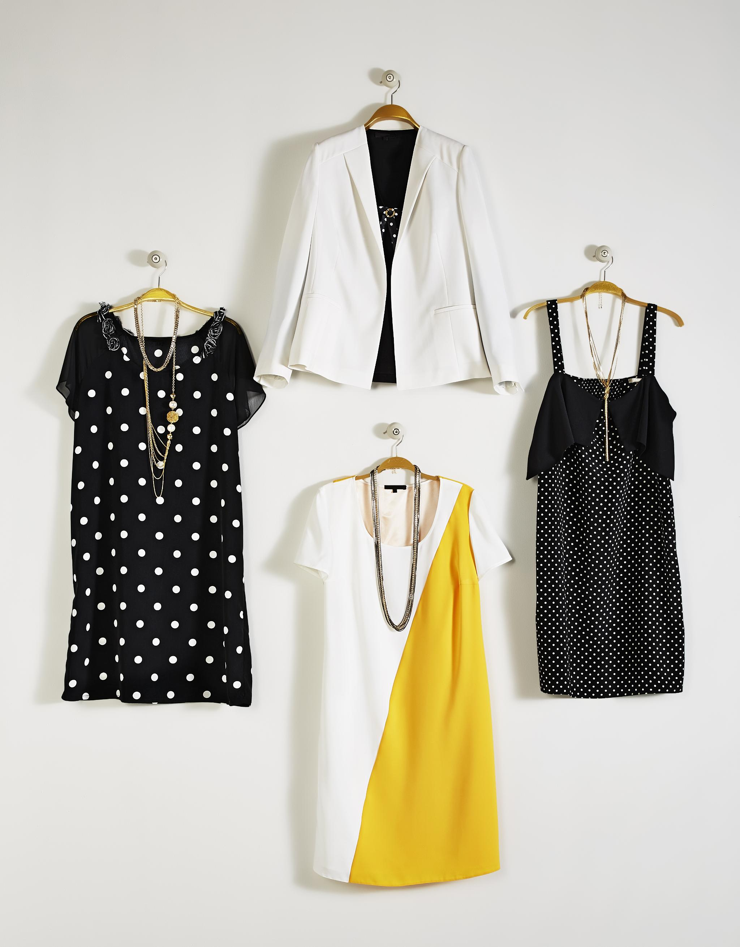
Boosting Credibility and Sales
Influencer Collaboration
Aligning with brand values and image
Accessing influencer's follower base
Authentic Endorsements
Enhancing brand credibility
Creating relatable content
Sales Impact
Leveraging influencer's trust to drive sales
Notes:
Consider partnering with influencers who resonate with your brand's ethos. Their genuine endorsements can captivate their audience, enhance your brand's trustworthiness, and ultimately, escalate your sales figures. Original Content: Partner with influencers who align with your brand. Their endorsement can introduce your clothing line to their followers. Authentic influencer content can boost credibility and drive sales.

Slide 17
Engagement and Community Building

Slide 18

Prompt Response and Interaction
Effective Communication
Respond promptly to comments, messages, and mentions
Interactive Engagement
Engage with followers through questions and contests
Community Building
Host live sessions to foster a loyal brand community
Notes:
Let's explore how to maximize social media engagement. Respond quickly to any interactions, create interactive experiences, and build a loyal community through live events. Original Content: Respond promptly to comments, messages, and mentions. Engage with your followers by asking questions, running contests, and hosting live sessions. Build a loyal community around your brand.

Slide 19
Analytics and Optimization

Slide 20
Tracking Metrics and Adjusting Strategy
Engagement Analysis
Track likes, comments, and shares to measure audience interaction
Reach Evaluation
Assess the extent of content visibility across the platform
Click-Through Rates
Analyze the ratio of clicks to impressions on your links
Conversion Rates
Measure the percentage of users who take the desired action
Data-Driven Strategy Adjustment
Modify tactics based on analytical insights and performance metrics
Notes:
Let's focus on key metrics to evaluate our social media performance. We'll delve into engagement, reach, click-through, and conversion rates, and use these insights to refine our strategy. Original Content: Regularly analyze your social media performance. Track metrics such as engagement, reach, click-through rates, and conversion rates. Adjust your strategy based on data insights.

Slide 21
Real-Time Strategy Adaptation
Principles and Applications

Slide 22
Staying Updated on Trends
Dynamic Evolution of Social Media
Stay informed on platform changes and algorithm updates
Monitor emerging features regularly
Strategic Agility
Adapt your strategy swiftly to maintain relevance
Notes:
Social media is ever-changing, with new updates and features emerging constantly. It's crucial to stay informed and adapt our strategies quickly to keep up with these rapid developments. Original Content: Social media trends evolve rapidly. Stay updated on platform changes, algorithm updates, and emerging features. Be agile in adapting your strategy to stay relevant.

Slide 23

Summary and Additional Resources: Creating Meaningful Connections
Essence of Social Media Strategy
Not just about posting content
Creating meaningful audience connections
Driving Business Results
Strategy aligned with business goals
Wishing Success
Encouragement for social media endeavours
Notes:
A successful social media strategy transcends mere content posting. It's about forging meaningful connections and driving tangible business results. Here's to your success in the social media realm! Original Content: Remember, a successful social media strategy isn't just about posting content—it's about creating meaningful connections with your audience and driving business results. Good luck with your social media endeavours!

Slide 24

Summary and Additional Resources: Exploring Further Articles
Insightful Articles and Platforms
Article by Jack Shepherd on effective strategies
Dynamo's platform for enhancing social conversions
Efficient Management Tips
Time-saving techniques for managing social media
Notes:
Explore Jack Shepherd's article for strategic insights and Dynamo's platform for boosting social conversions, along with time-saving social media management tips. Original Content: For more detailed examples and insights, you can explore articles like "Social Media Marketing for Fashion Brands: A Strategy That Works" by Jack Shepherd. Additionally, consider checking out Dynamo's revolutionary social conversion enhancement platform and time-saving tips for social media management.

